Slide 1
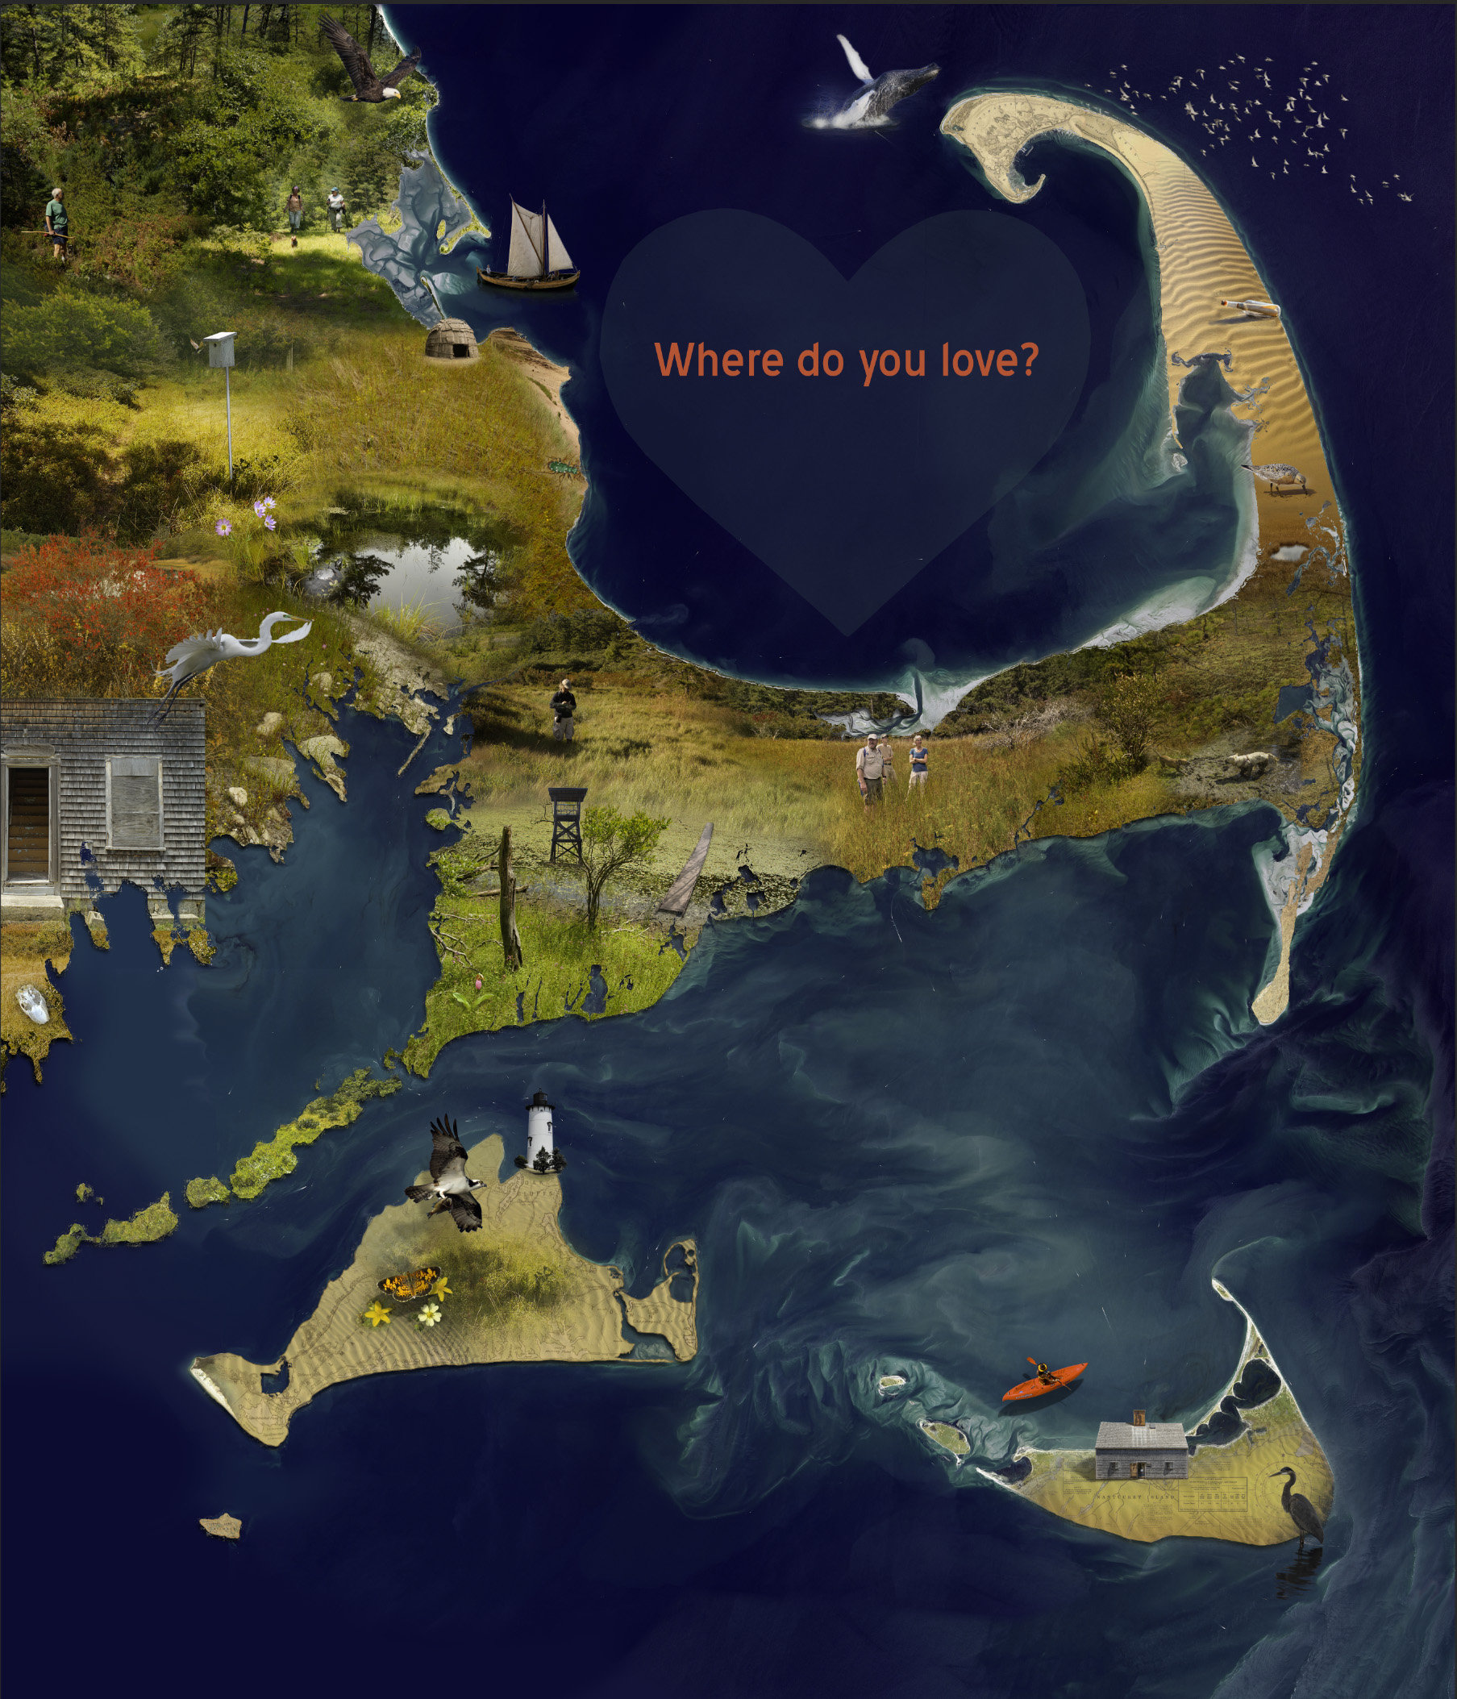
Do You See What I See? Regional Conservation Planning Workshop
Massachusetts Coastal Pine Barrens Partnership
Carver Public Library
July 10, 2019
Notes:
Thank you for coming.
Vision for a Regional Conservation Plan for the Massachusetts Coastal Pine Barrens is shared by the Pine Barrens Partnership Steering Committee.

Slide 2
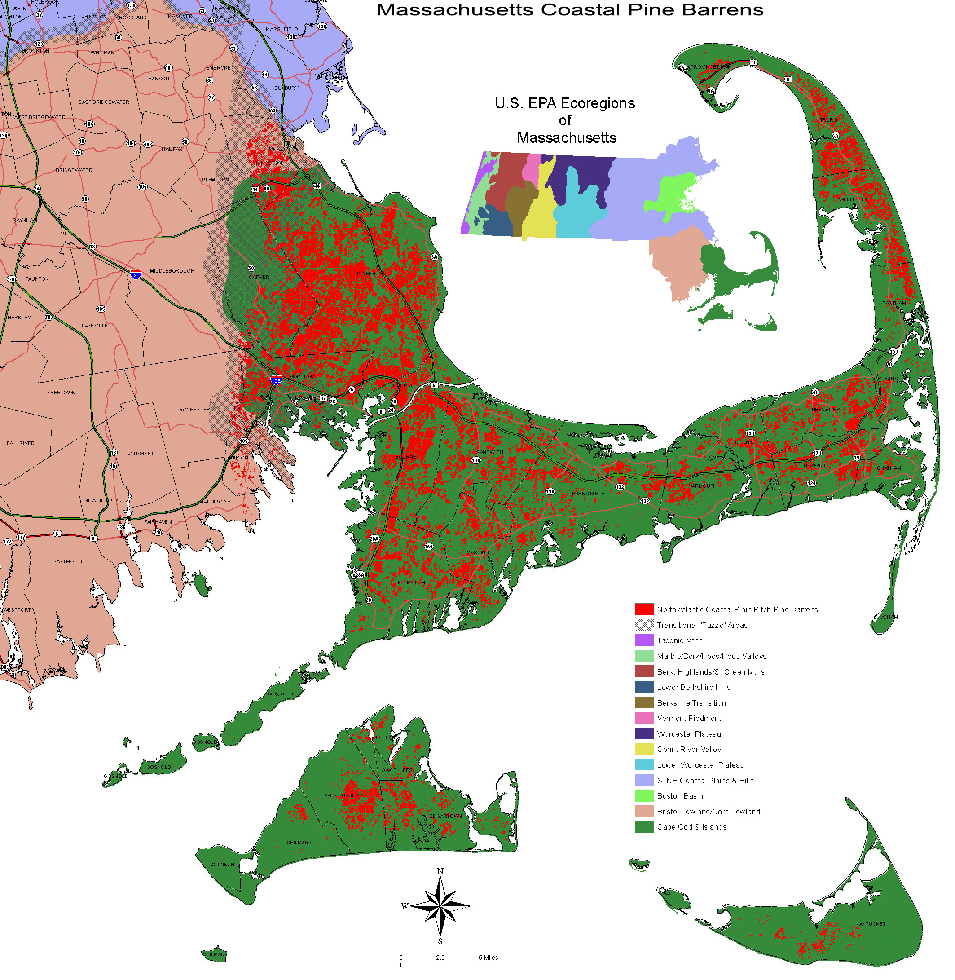
Massachusetts Coastal Pine Barrens Regional Conservation Partnership (RCP)
FOCUS:
Regional
Conservation
Planning
Notes:
Photo source: https://sippican.villagesoup.com/p/local-pine-barrens-hold-unique-ecological-diversity/1367766

Slide 3
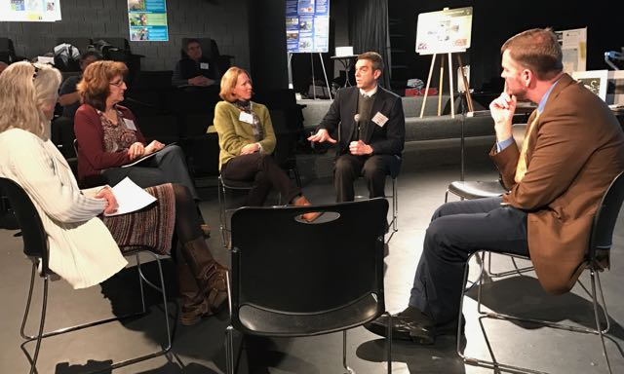
What is an RCP?
An informal partnership created to advance the pace of conservation
May involve private and public organizations, agencies, non-profits and citizens
Participants work together to develop and implement a shared, long-term conservation vision across boundaries

Slide 4
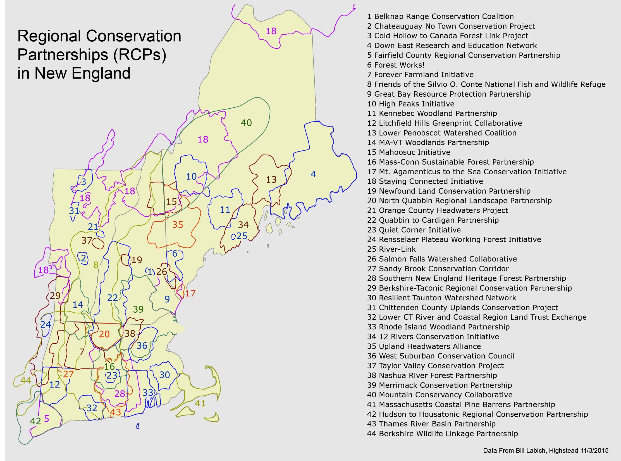
Notes:
Insert New England RCP map (can we use this?)
Notes: As you can see here, creating a Partnership allows organizations to cover more space than they would be able to on their own, and it unites the efforts of conservation organizations so that instead of having hundreds of organizations covering different, small patches of land, we are able to apply a shared vision to larger areas. Good for publicity: One message and one voice will be heard better than many different voices spreading many different messages.

Slide 5
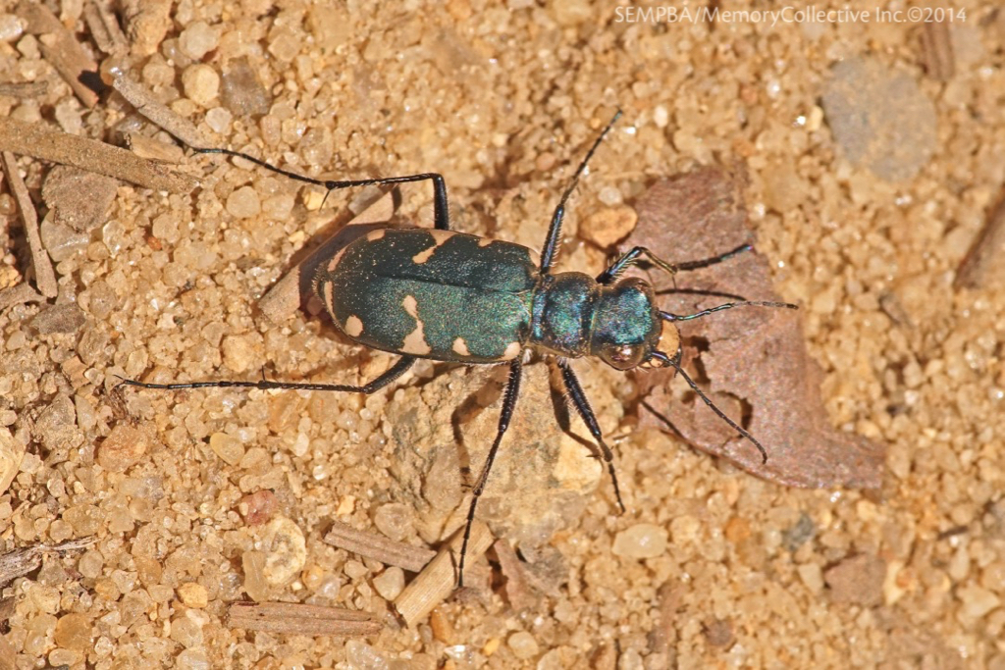
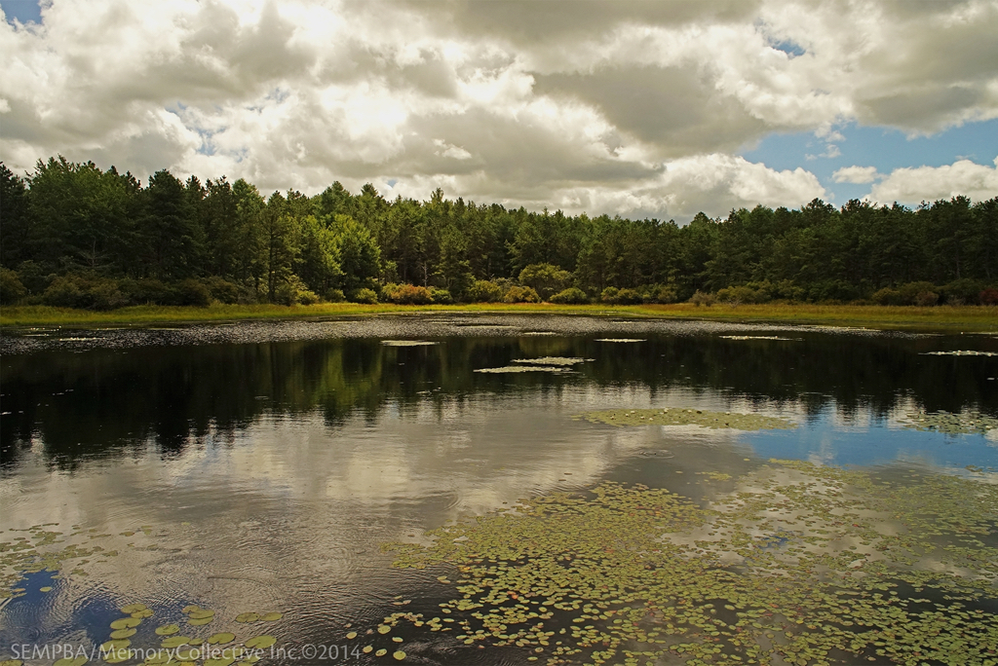
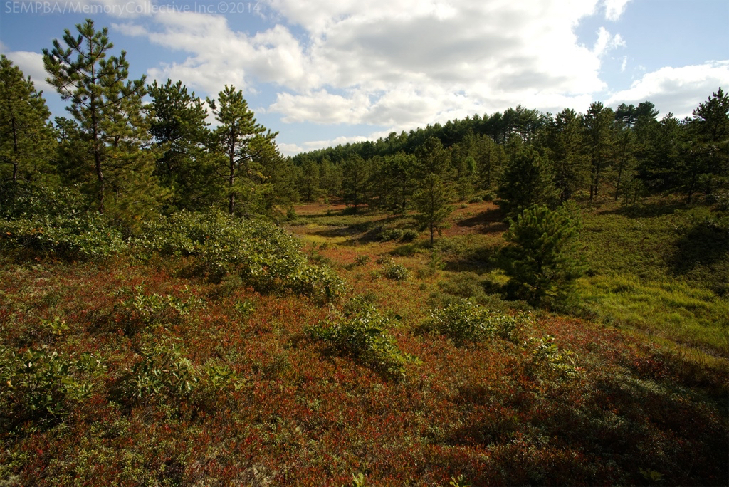
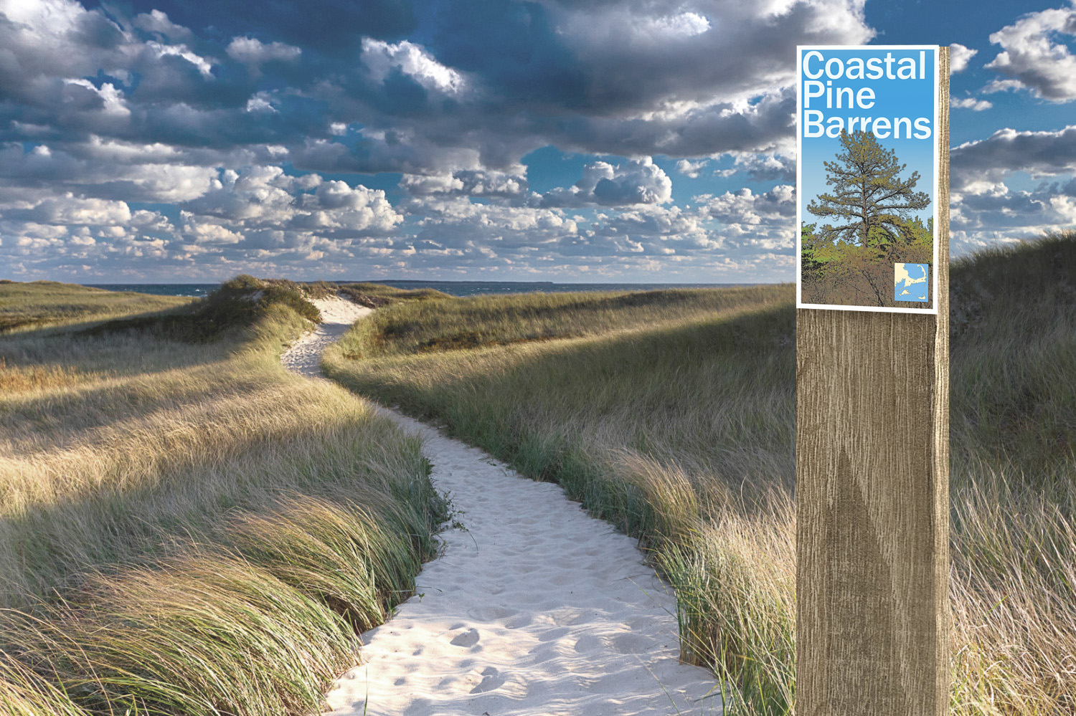
So much biodiversity. So little time.

Slide 6
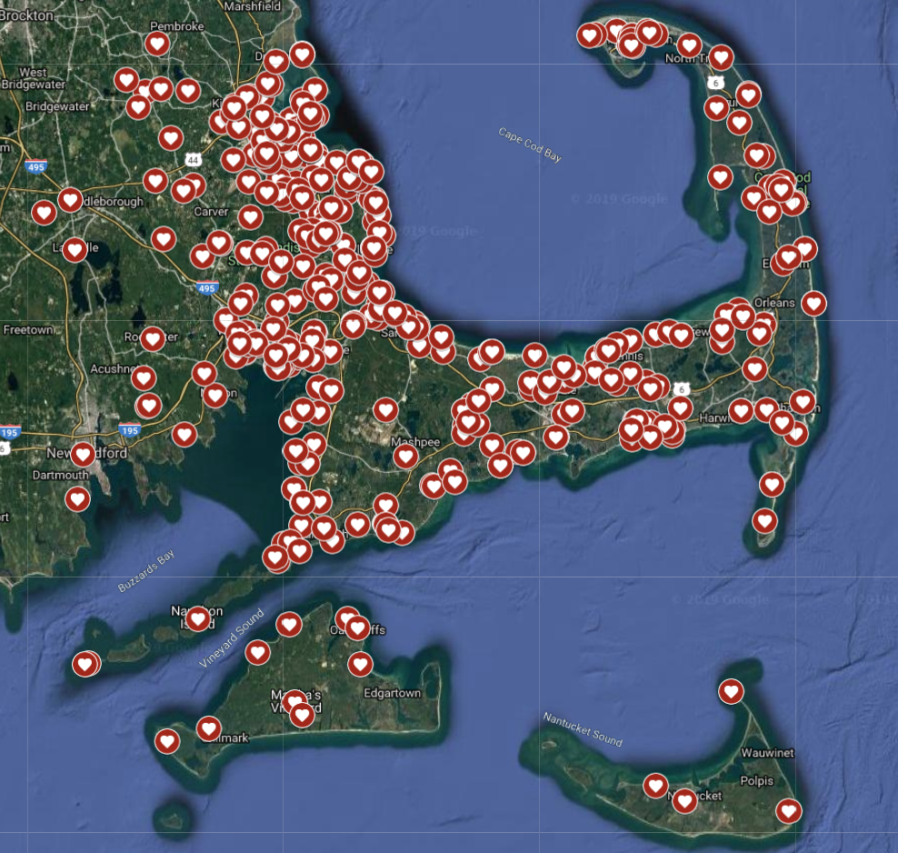
So Many Points of View.
Each one of them critical.

