Slide 1
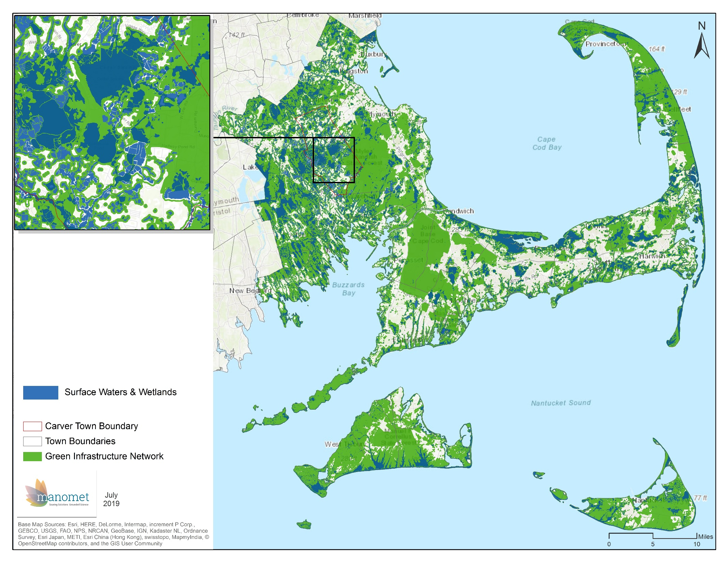
Water Features

Slide 2
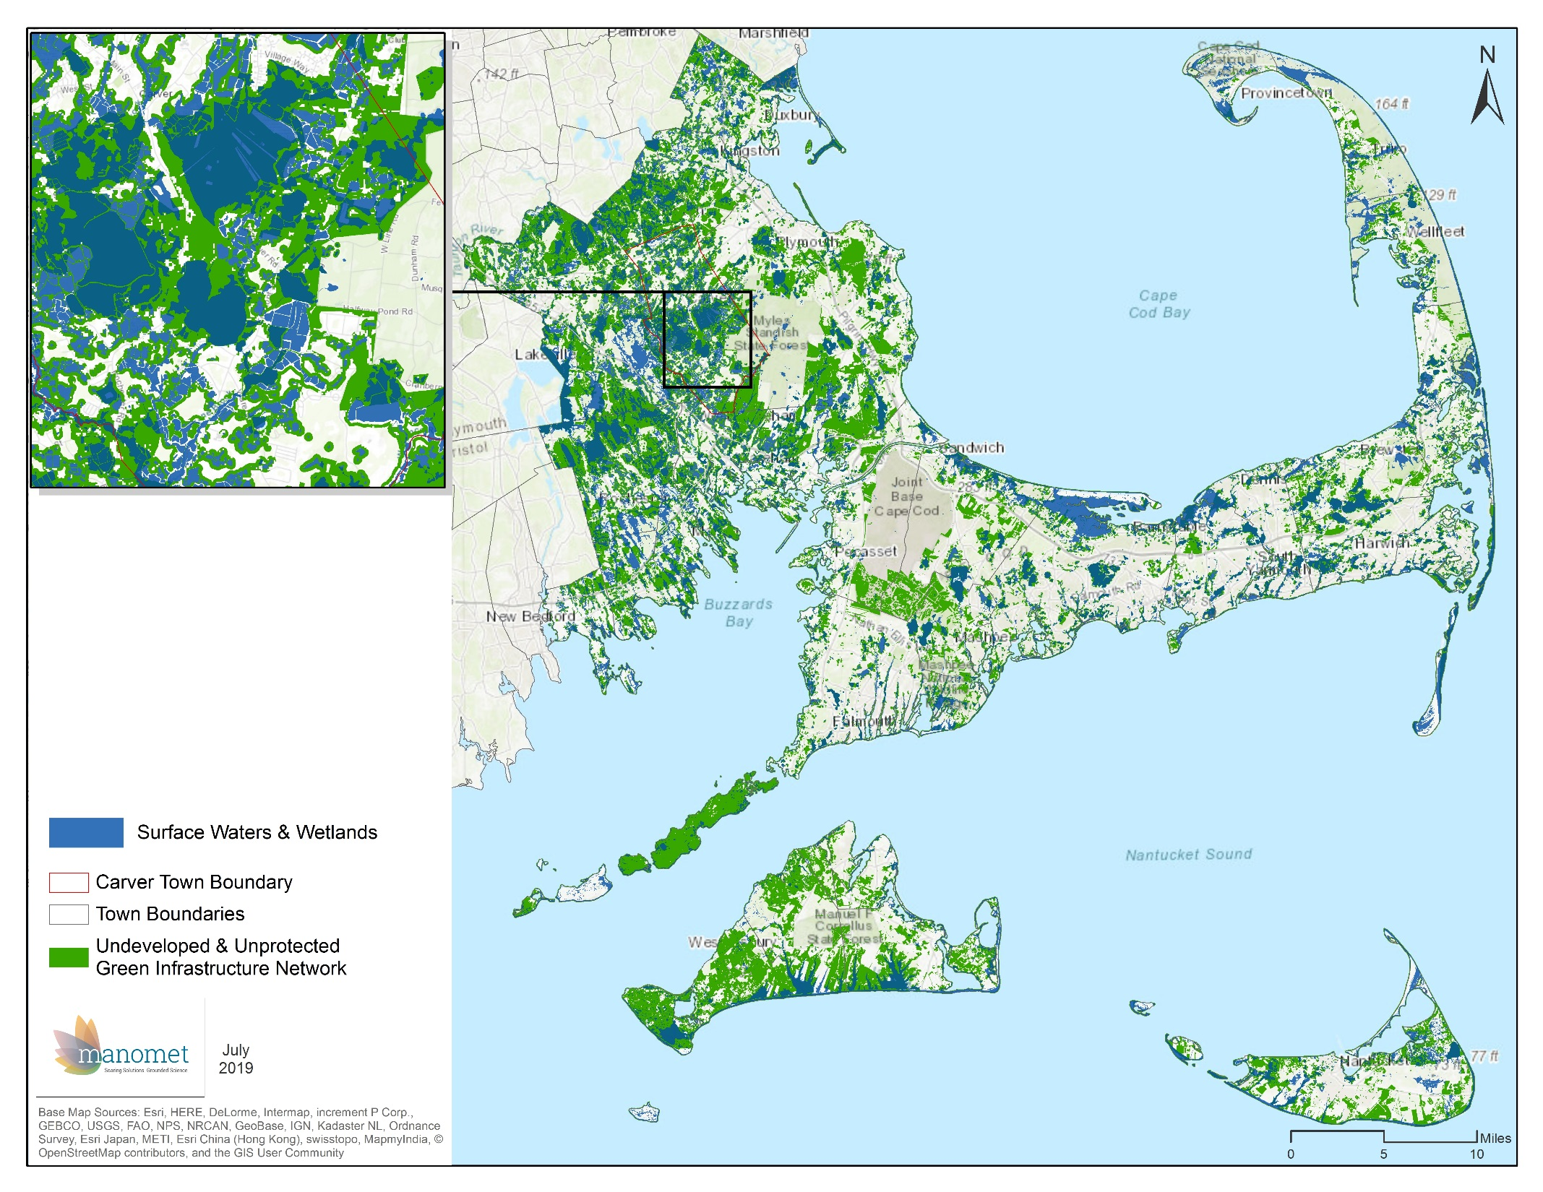
Water Features

Slide 3
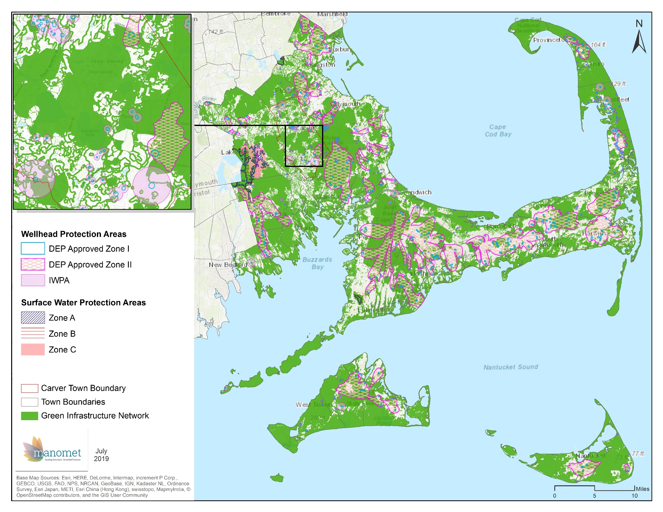
Drinking Water
Supplies

Slide 4
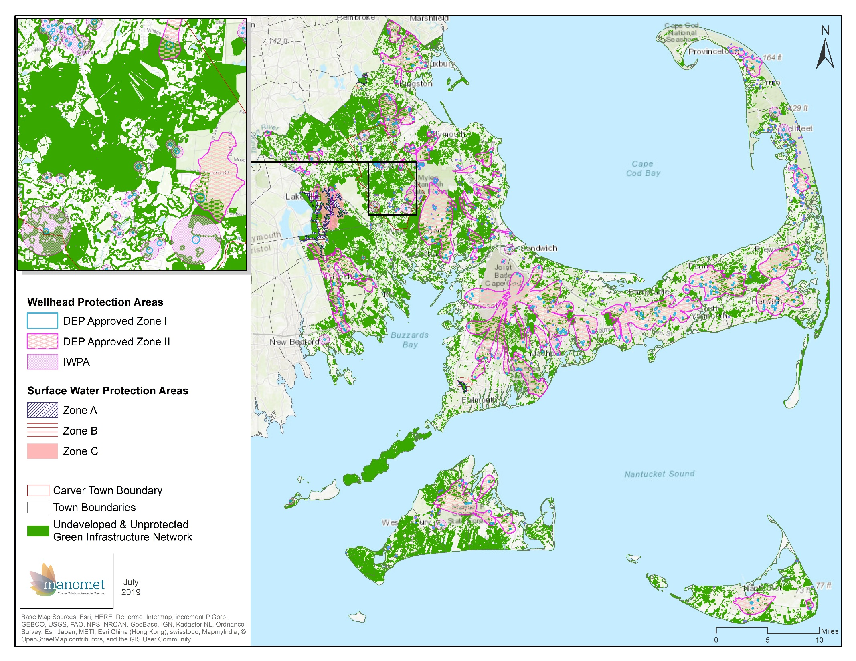
Drinking Water
Supplies

Slide 5
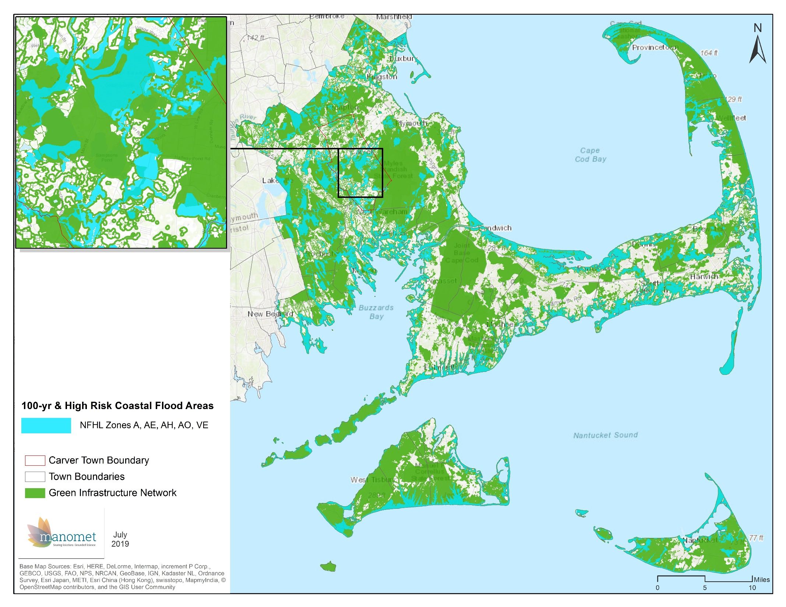
Flood Zones

Slide 6
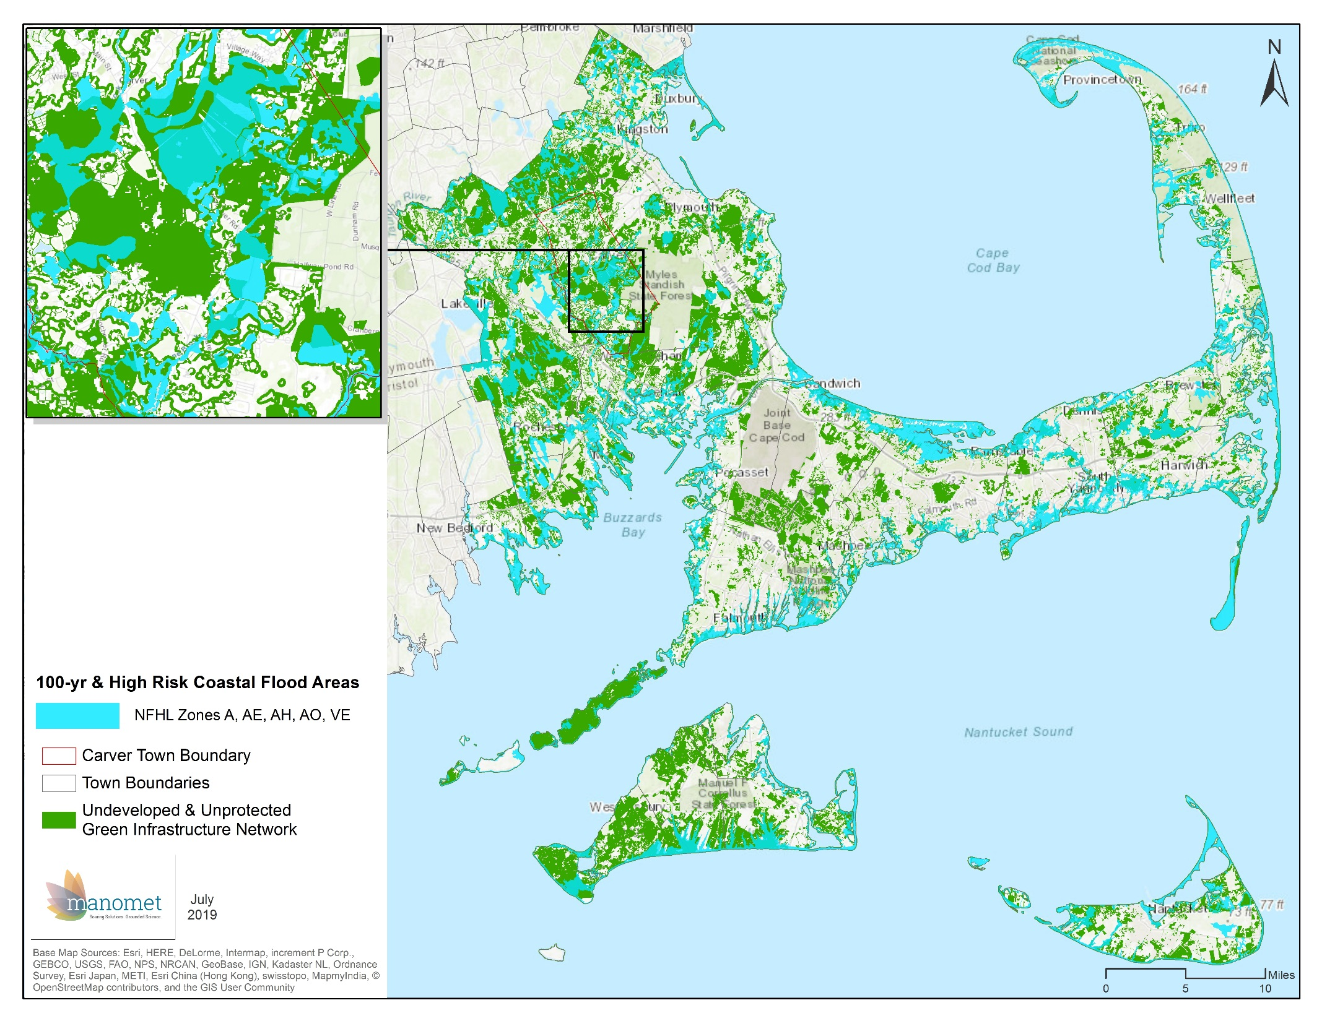
Flood Zones

Slide 7
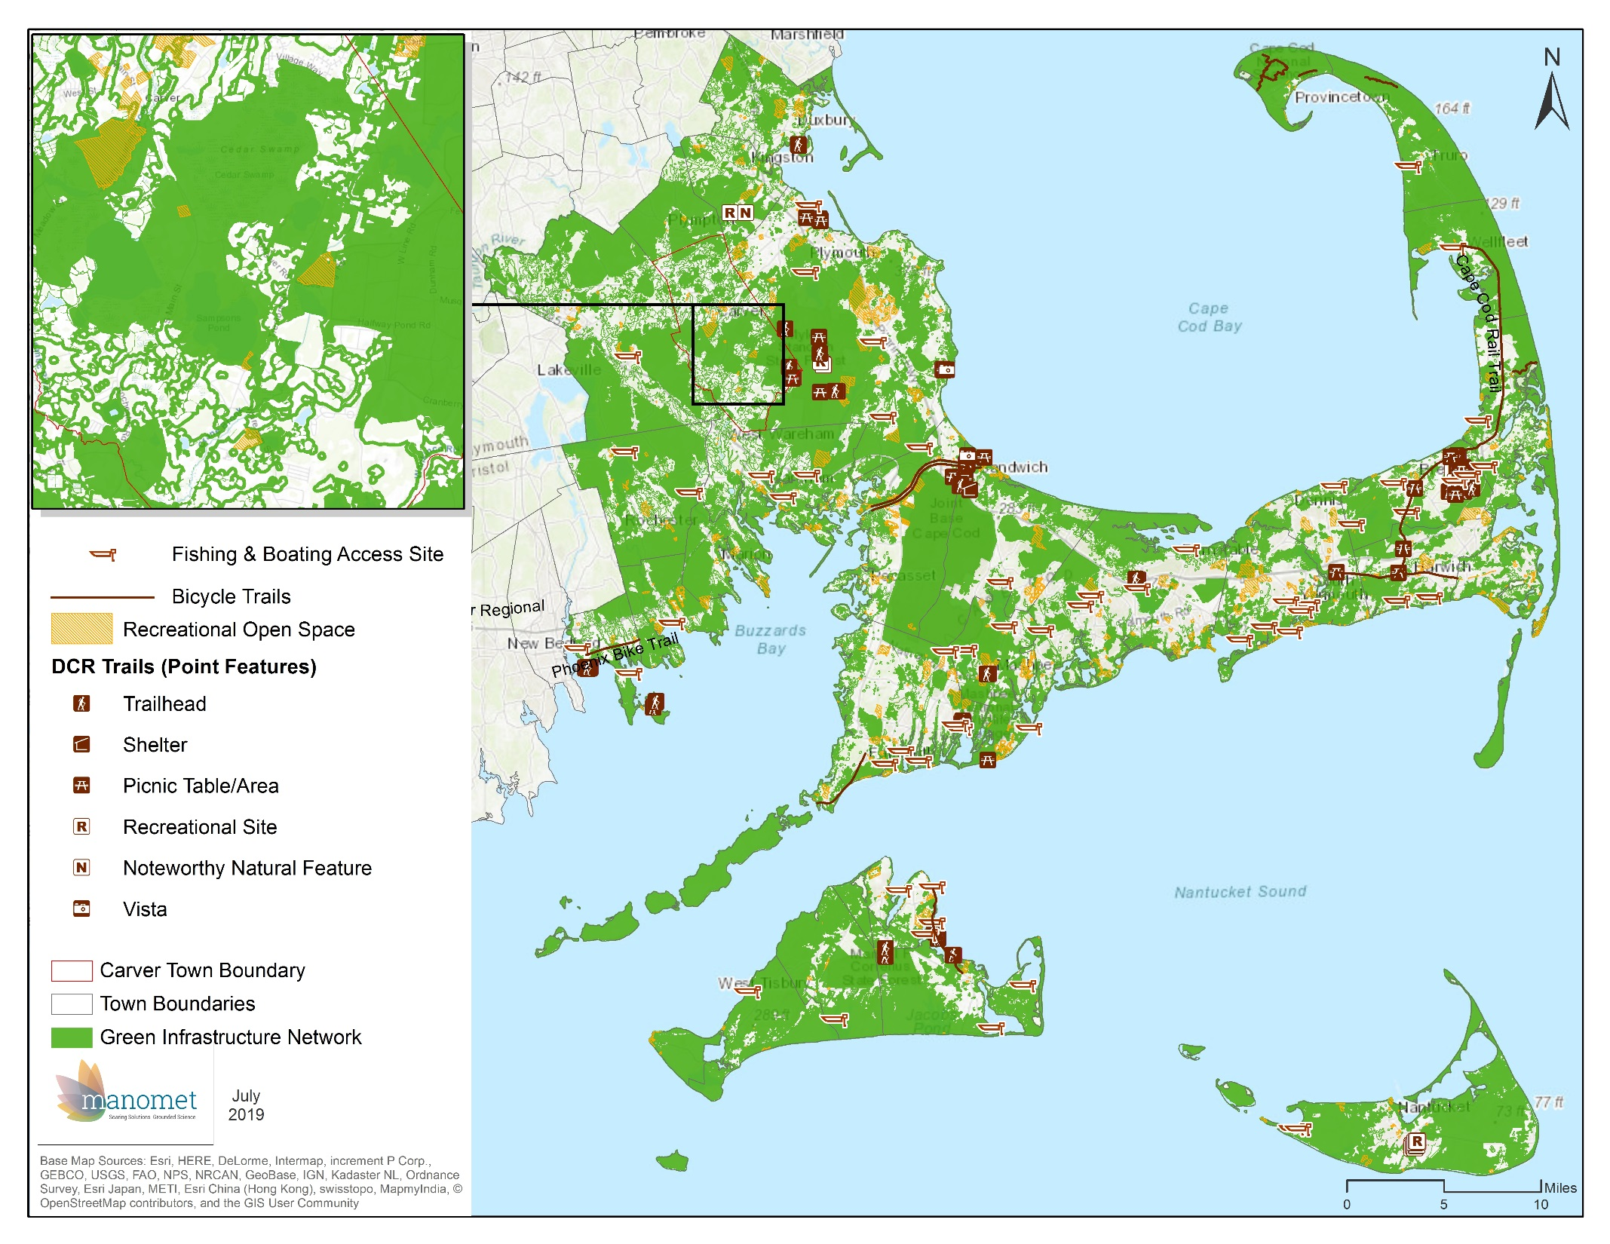
Recreational Areas

Slide 8
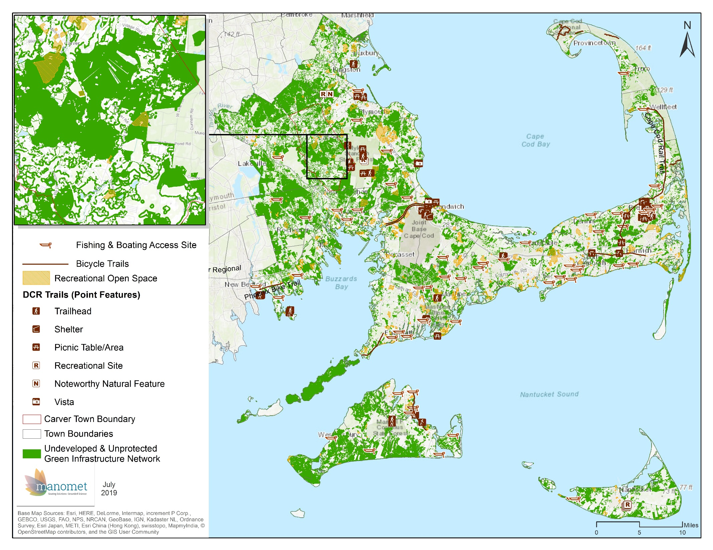
Recreational Areas

Slide 9
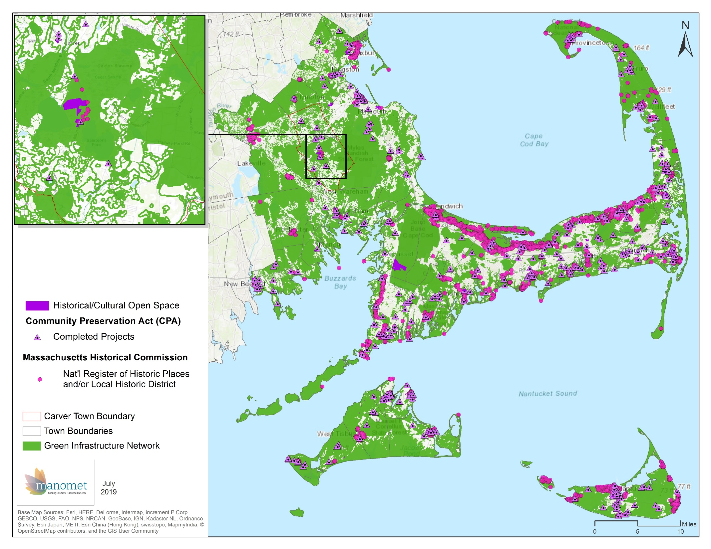
Areas of Historical
& Cultural Significance

Slide 10
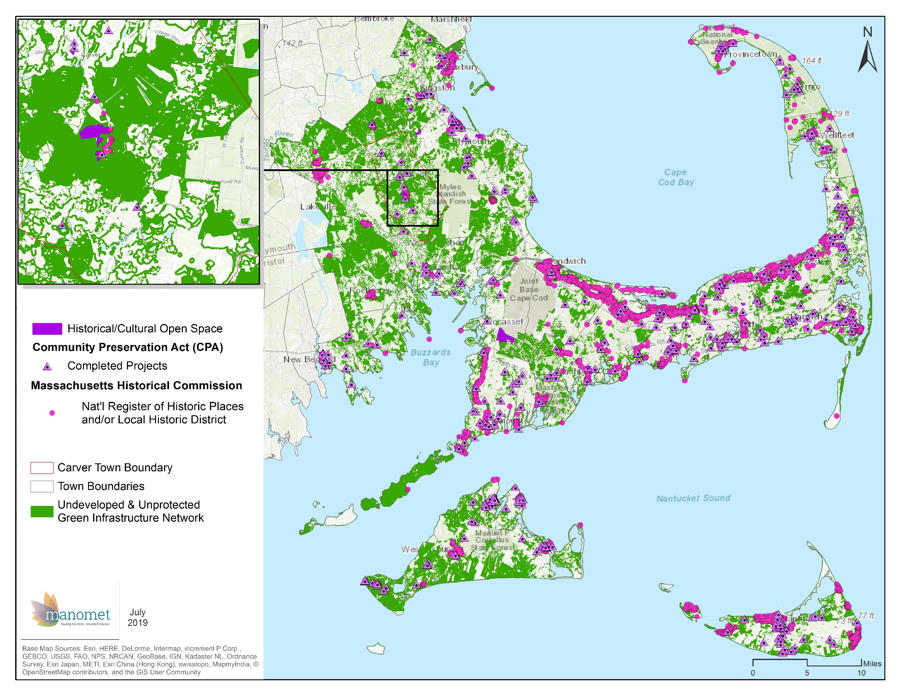
Areas of Historical
& Cultural Significance

