Slide 1


Integrating Resiliency and Green Infrastructure:
Massachusetts Case Studies
Heather McElroy, Natural Resources Program Manager
Eric Walberg, AICP: Senior Program Leader, Climate Services

Slide 2

Case Study Strategies
Identifying and protecting vulnerable areas containing critical green infrastructure
Removing dams and restoring natural river function/processes
Reclaiming Floodplain
Repurposing degraded portions of the built environment while integrating the resiliency built into the natural environment

Slide 3
Mill River Park
Taunton, MA
Former police auto impoundment area in Taunton, MA
Site fronts the Mill River
Transformed into a public park with green infrastructure-base storm water treatment and associated educational signage

Slide 4
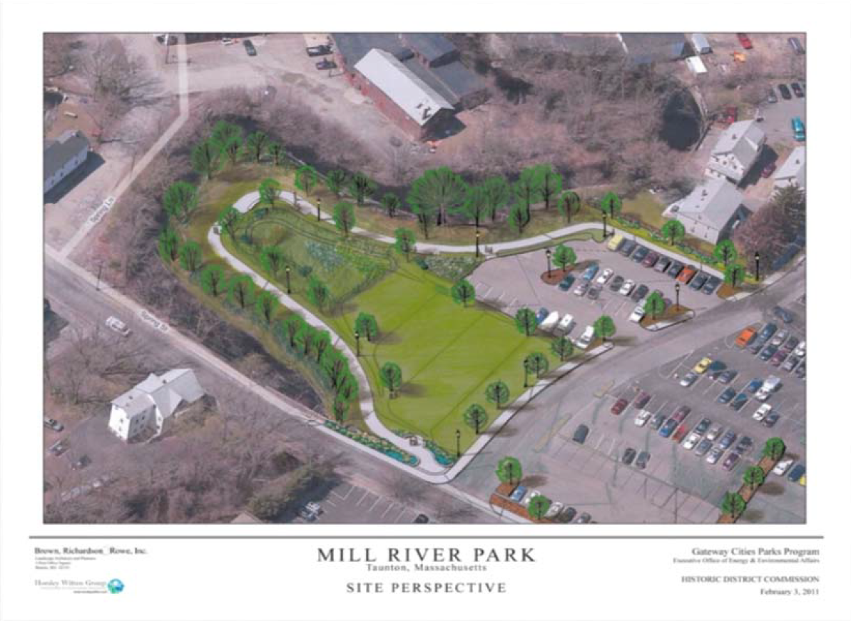

Slide 5
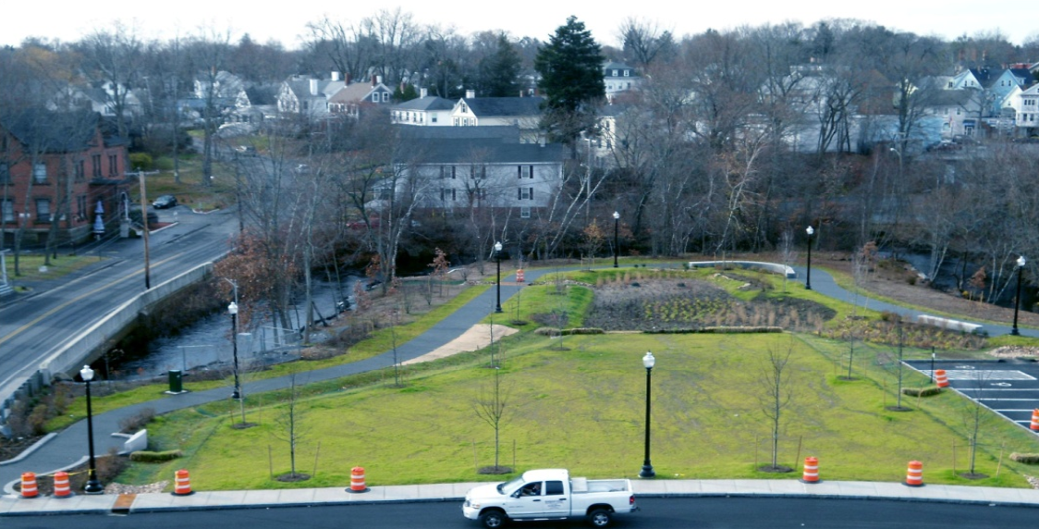

Slide 6
Whittenton Mill Dam Removal
Taunton, MA
Whittenton Mill Dam was failing prior to removal
2005 flood caused evacuation of portions of Taunton due to safety concerns
Evacuating Taunton during near dam failure cost $1.5 million
Repairing the Dam would have cost $1.9 million
Removing the Whittenton Dam cost $440,000

Slide 10
Whittenton Mill Dam Removal
Taunton, MA
Restored diadromous fish passage, increasing recreational and fishing opportunities
The area of the former reservoir adds flood storage capacity and reduces flood risks
Water quality has improved without the reservoir, and there are fewer algal blooms and associated fish kills

Slide 11
Little Pond Shellfish Project
Falmouth, MA
Little Pond is a salt water estuary with water quality problems
Head of pond includes harbor and marina, coastal development
Project purpose is to test removal of nitrogen from water using shellfish
2.5 million oysters are being grown in floating bags
Water quality monitoring program; plan to collect 3 years data
Other shellfish propagation pilots around the Cape…

Slide 12
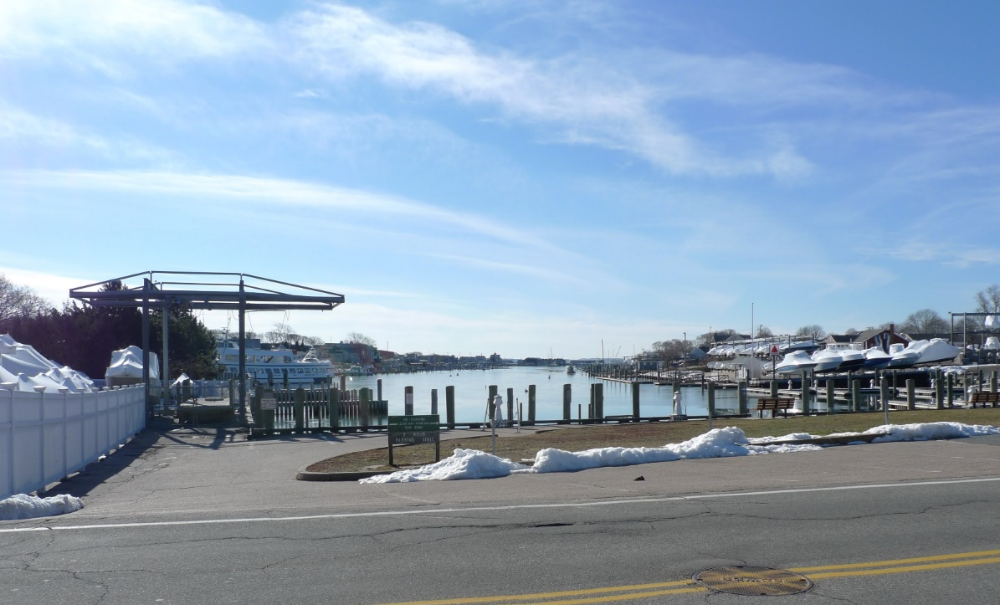
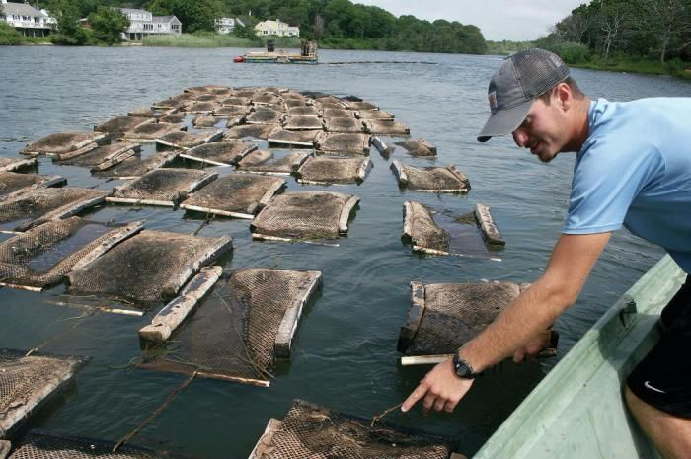

Slide 13
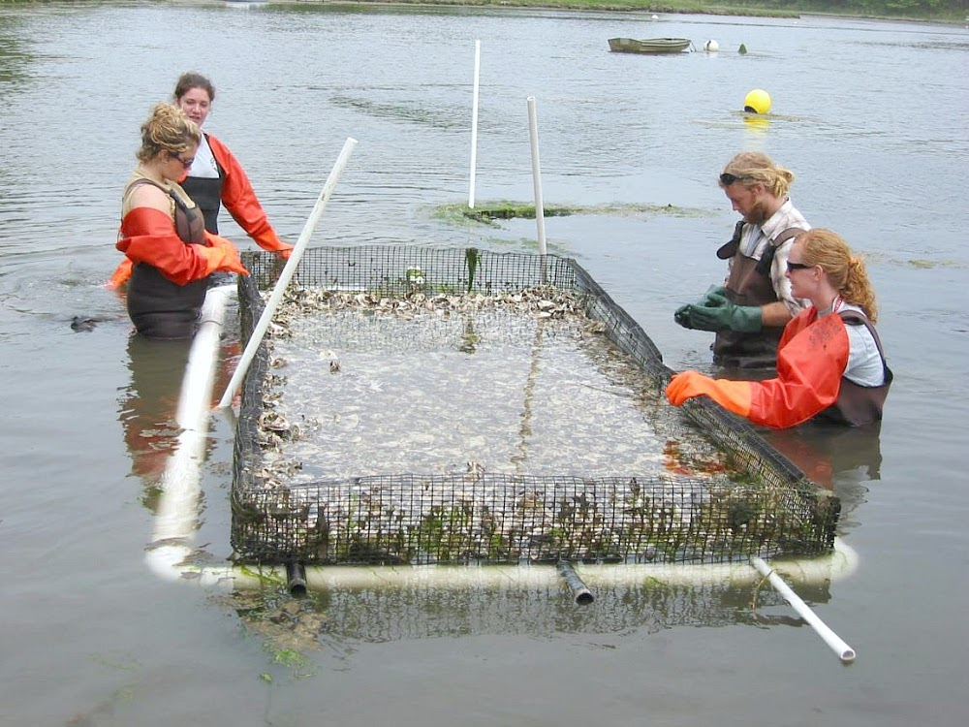
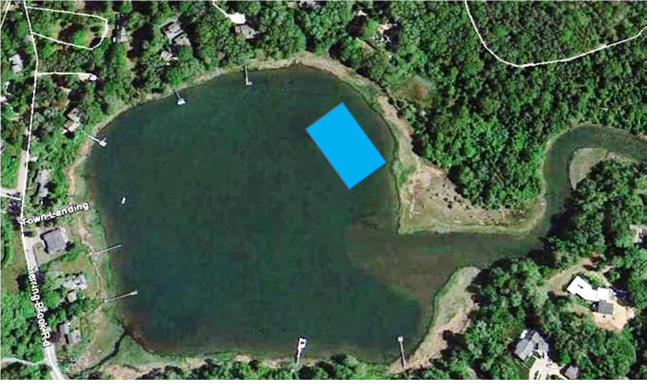

Slide 14
Muddy Creek Wetland Restoration
Harwich/Chatham, MA
Tidally restricted creek on Pleasant Bay; undersized culvert
Project replaced culvert with a 94 ft bridge
Restored tidal flow and salinity in estuary
Change in vegetation, restoration of salt marsh, fish passage, improved habitat, invasive species abatement, recreational access

Slide 15
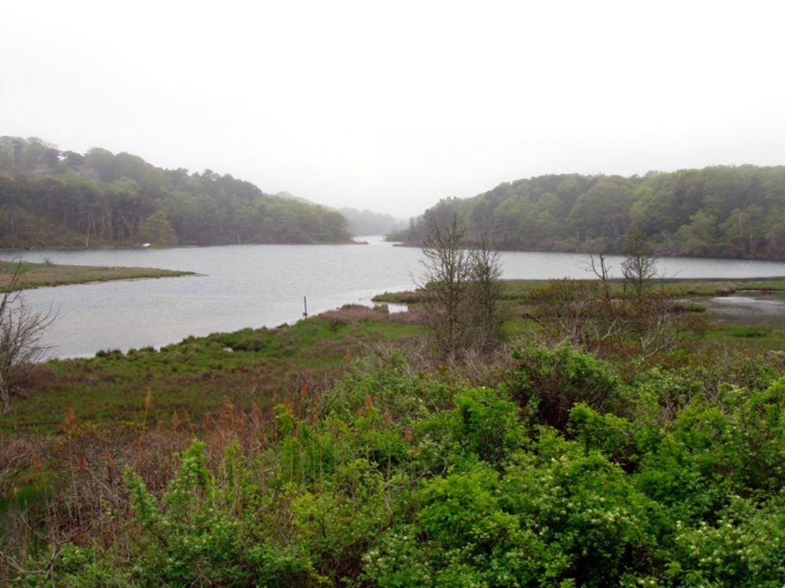

Slide 16
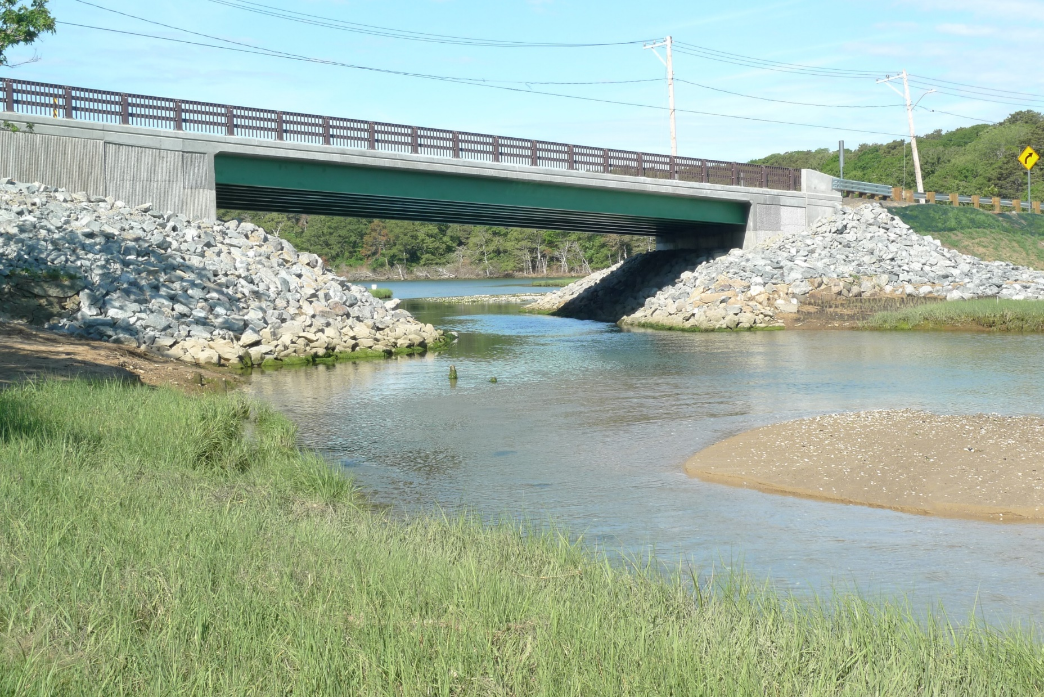

Slide 17
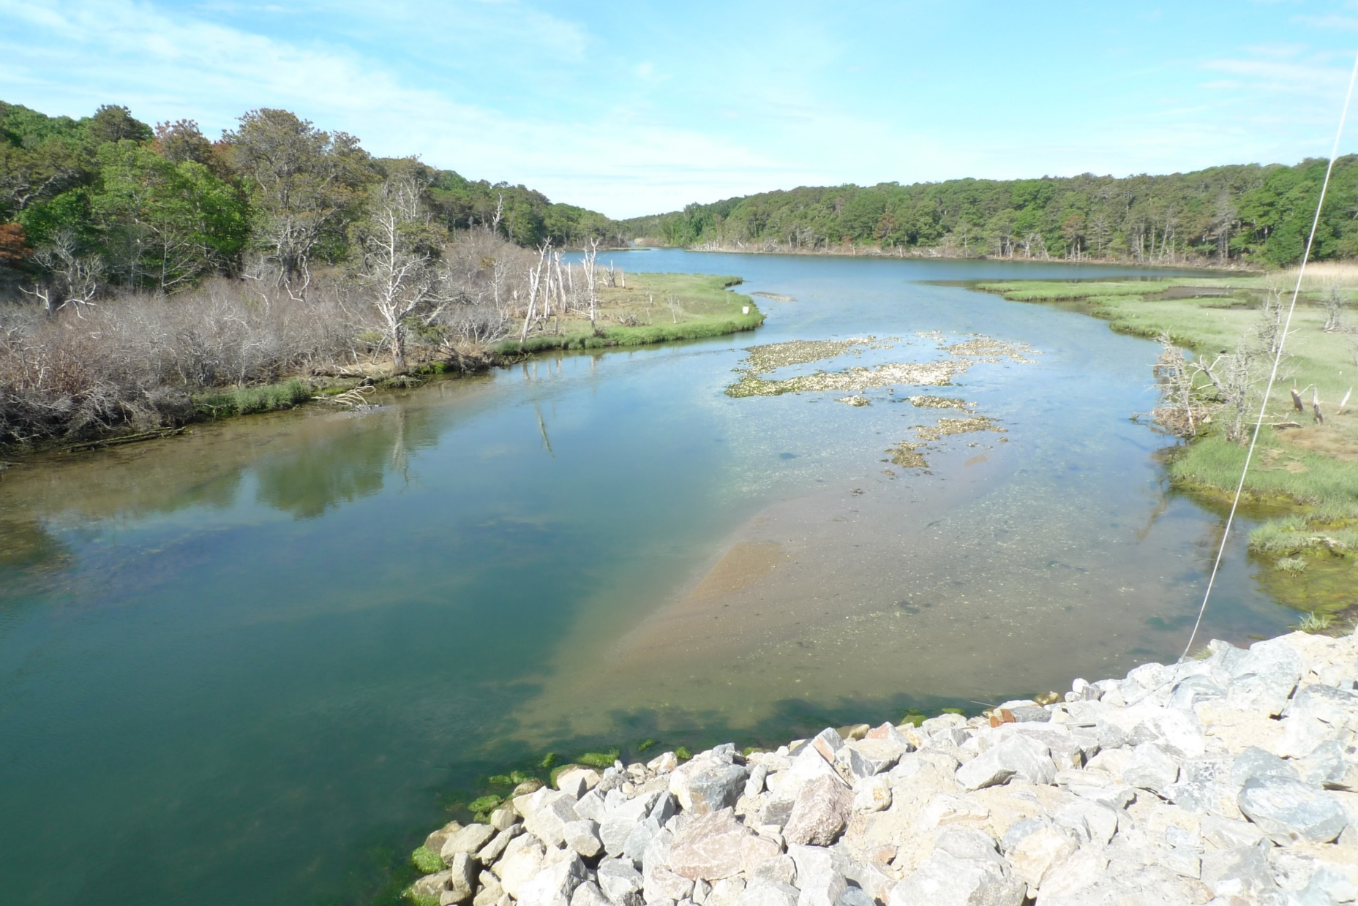

Slide 18
Project Funding
Municipal Funds
Chapter 90 Funds
MassWorks Infrastructure Program if related to economic development and jobs creation programs
TIP Project listing
FEMA/MEMA
DEP Section 604(b) and Section 319 Grant Programs
Division of Ecological Restoration Grants Program
Public – Private Partnership
MA CZM Coastal Pollution Remediation Grants (CPR)

Slide 19
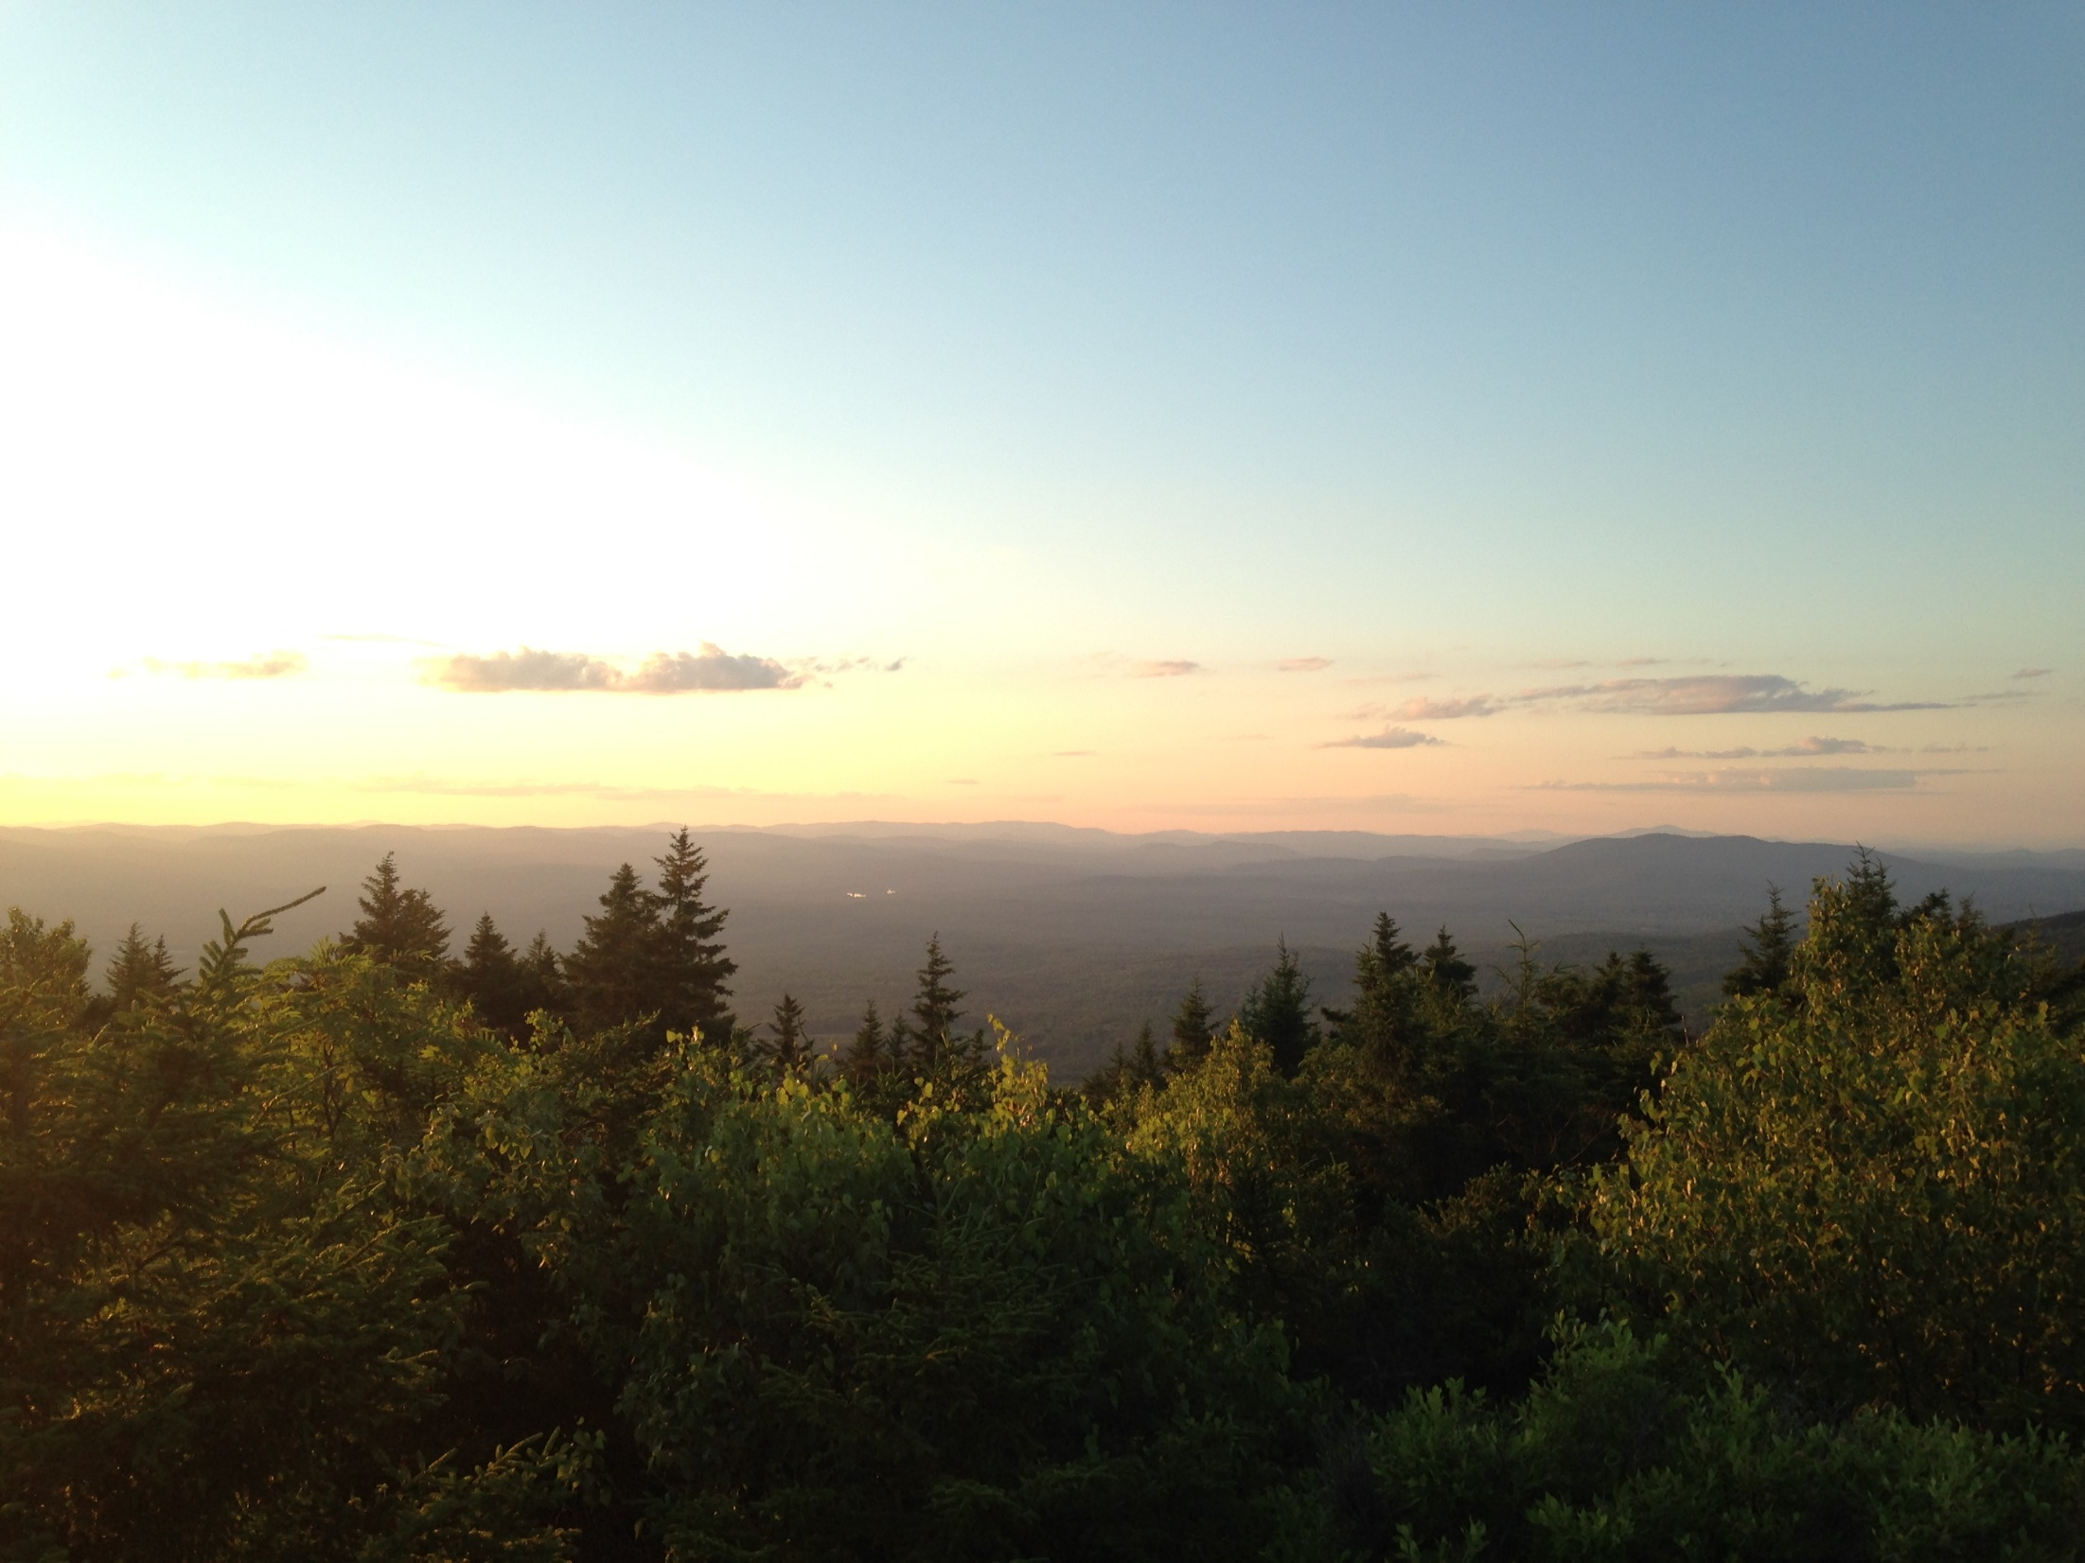
Thank You

