Slide 1
Regional Conservation Planning Workshop
Eric Walberg, AICP
Senior Program Leader, Climate Services

Slide 2
Overarching Project Goal
Creation of a conservation vision map that can serve as are regional standard
Implementation of the conservation vision through inclusion in local planning and management decisions

Slide 3
Goals for the Workshop
Improve understanding of:
How the combined stressors of climate change and continued urbanization are likely to impact ecosystems in southeastern Massachusetts
How green infrastructure can respond to these stressors and enhance local and regional resiliency

Slide 4
Goals for the Workshop
Spark discussion on how to best integrate local and regional planning goals
Improve the map such that:
It better supports local planning priorities
Minimizes conflicts between local and regional priorities

Slide 5
Workshop Structure
Tim: Overview of our coastal pine barrens
Heather: Draft story map
Alissa: Regional priorities
Jen: Overview of draft green infrastructure map
Eric: Intersection of regional priorities and green infrastructure map
Critique of the map
Examples of implementation
Closing discussion/next steps

Slide 6
What is Green Infrastructure?
Green Infrastructure: A network of waterways, wetlands, woodlands, wildlife habitats, and other natural areas that support native species, maintain natural ecological processes, sustain air and water resources and contribute to health and quality of life.
(McDonald, Benedict and O’Conner, 2005).

Slide 7
Types of Green Infrastructure Features
Undeveloped coastal reaches:
Intact dune system
Unimpeded sediment transport
Healthy tidal and non-tidal wetlands

Slide 8
Types of Green Infrastructure Features
Undeveloped riparian corridors
Mix of wetland and upland features
Wetlands complexes
Forested uplands

Slide 9
Types of Green Infrastructure Features
Reconstructed features:
Constructed wetlands and dunes
Sediment replenishment (beach nourishment)
Restoration of riparian corridors
Reforestation

Slide 10
Types of Green Infrastructure Features
Hybrid features:
Living shorelines
Stormwater management through features such as constructed wetlands and rain gardens

Slide 11
Global Temperature Anomalies
Animation of Global Surface Temperature Anomalies from 1880-2018. Source: NASA/GSFC Scientific Visualization Studio

Slide 12
Observed Precipitation Change Current average compared to first half of previous century

Slide 13
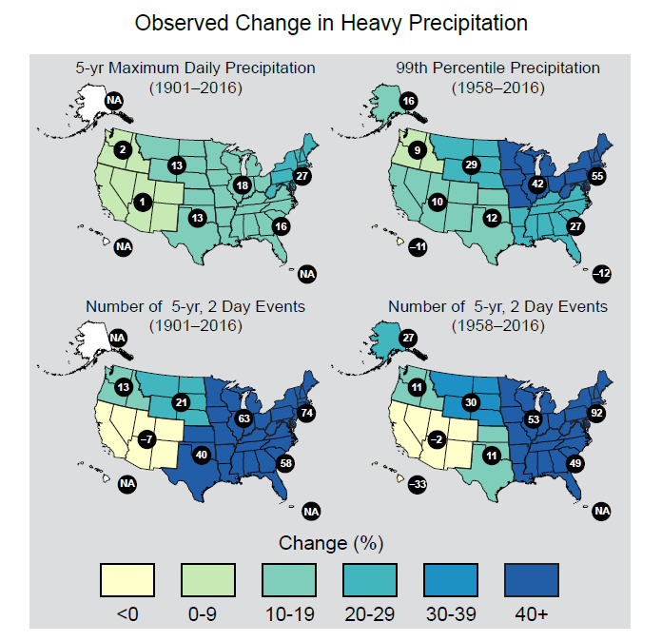
Notes:
Figure 7.4: These maps show the change in several metrics of extreme precipitation by NCA4 region, including (upper
left) the maximum daily precipitation in consecutive 5-year blocks, (upper right) the amount of precipitation falling in
daily events that exceed the 99th percentile of all non-zero precipitation days, (lower left) the number of 2-day events
with a precipitation total exceeding the largest 2-day amount that is expected to occur, on average, only once every 5
years, as calculated over 1901–2016, and (lower right) the number of 2-day events with a precipitation total exceeding
the largest 2-day amount that is expected to occur, on average, only once every 5 years, as calculated over 1958–2016.
The numerical value is the percent change over the entire period, either 1901–2016 or 1958–2016. The percentages
are first calculated for individual stations, then averaged over 2° latitude by 2° longitude grid boxes, and finally averaged
over each NCA4 region. Note that Alaska and Hawai‘i are not included in the 1901–2016 maps owing to a lack of
observations in the earlier part of the 20th century. (Figure source: CICS-NC and NOAA NCEI).

Slide 14
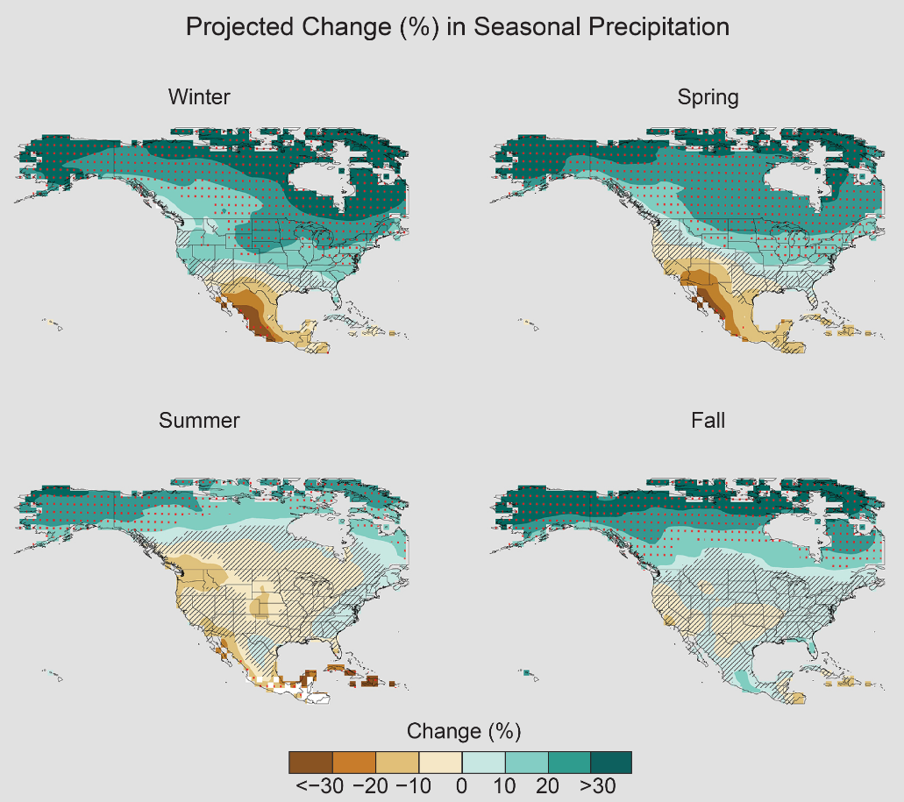
Notes:
Figure 7.5: Projected change (%) in total seasonal precipitation from CMIP5 simulations for 2070–2099. The values
are weighted multimodel means and expressed as the percent change relative to the 1976–2005 average. These
are results for the higher scenario (RCP8.5). Stippling indicates that changes are assessed to be large compared to
natural variations. Hatching indicates that changes are assessed to be small compared to natural variations. Blank regions
(if any) are where projections are assessed to be inconclusive. Data source: World Climate Research Program’s
(WCRP’s) Coupled Model Intercomparison Project. (Figure source: NOAA NCEI).

Slide 15
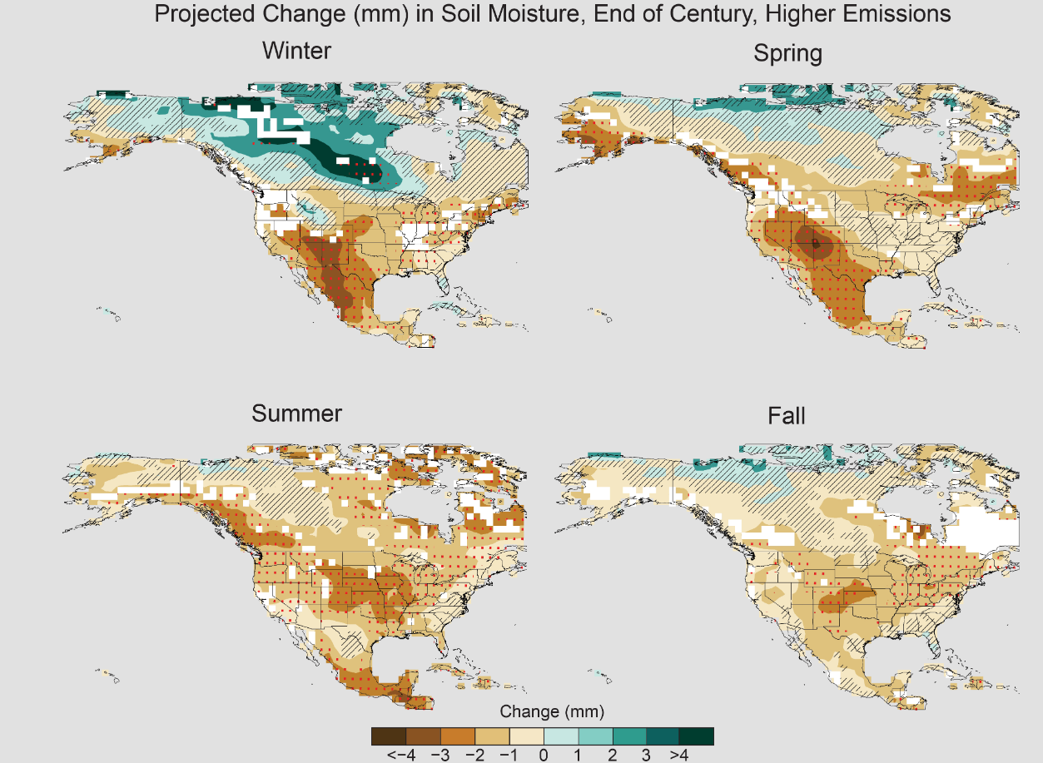

Slide 16
Source: James Hansen: http://www.columbia.edu/~jeh1/2013/AGU.11December2013.pdf

Slide 17
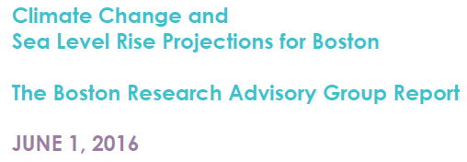
Projected Relative SLR Boston

Slide 18
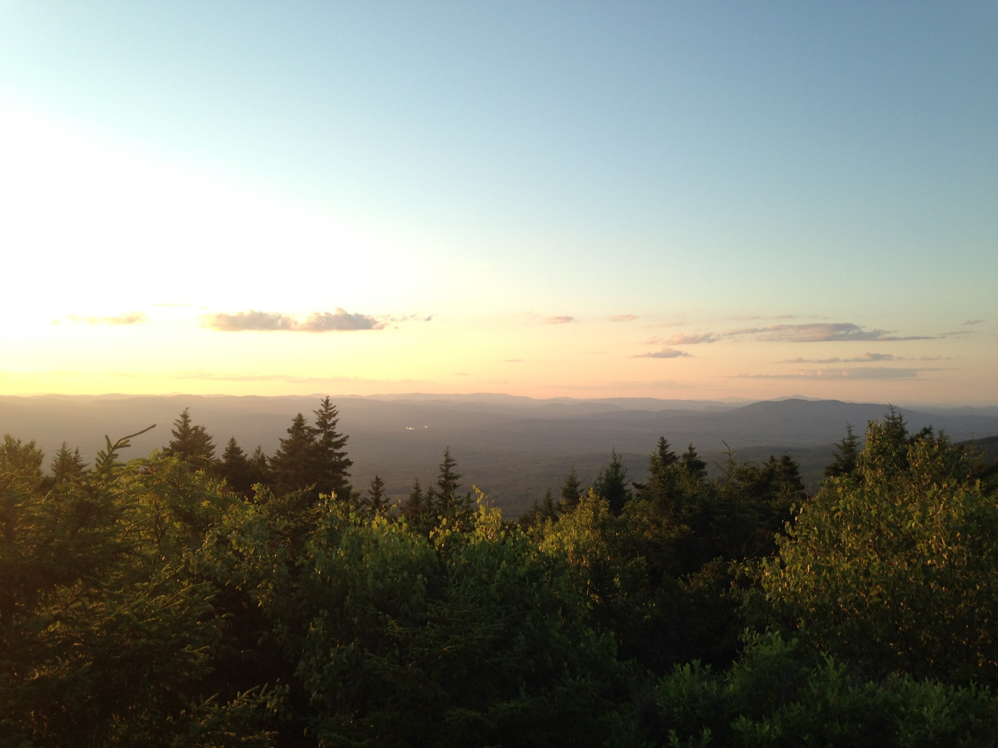
Thank You

